Slide 1

Customer Churn Analysis
Sreerag. S

Slide 2




Index
Demographic & Customer Analysis
Service Usage Analysis
Subscriptions & Billing Preference
Churn Analysis

Slide 3
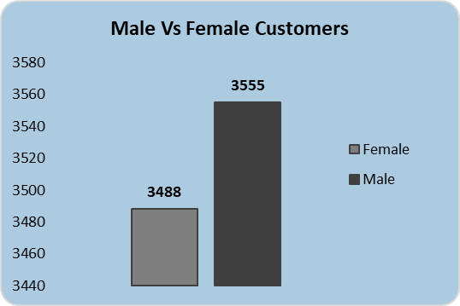
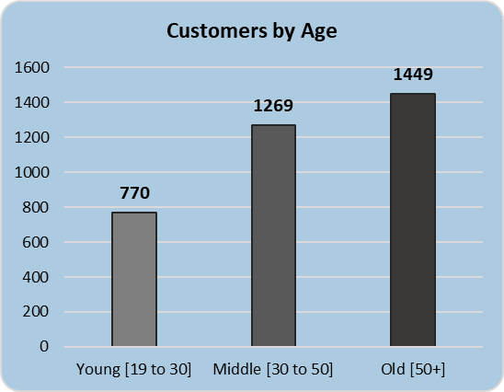
Demographic & Customer Analysis
From demographic & customer analysis, we can easily see that out male customers are more than that of female customer.
We can clearly state that women above the age of 50 are the most numbers of users and the young age group are less user, to increase the young user company can bring new offers based on internet usage such as extra GB of data, less price for streaming services ,etc.
The Customers are much higher in North California then the rest of the part of California.
Female Users Distribution

Slide 4
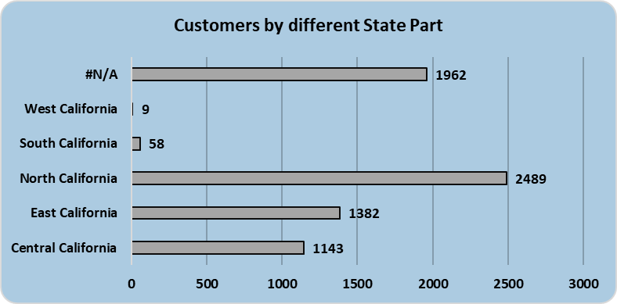
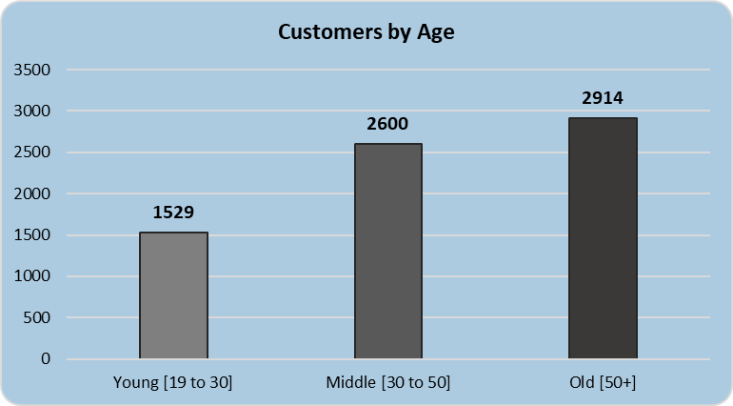
Demographic & Customer Analysis
Most Users are from North California more specifically more users are from Los Angeles.
In North California 1029 user are of age 50+, middle Age users are 884, young age users are 576.
This is because more users are shifted toward the competitors service provider.
Out of 2489 users,
710 users churned to competitor’s service.
Where 166 new customers joined for our services and 1613 customers stayed.

Slide 5
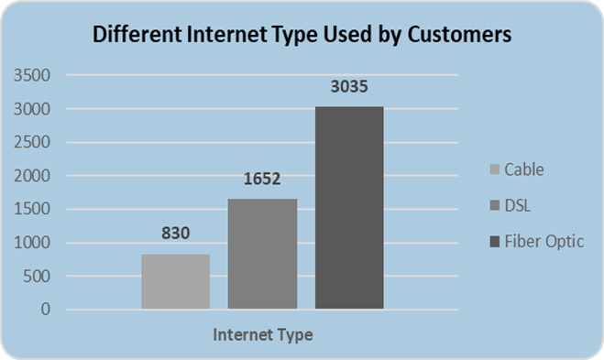
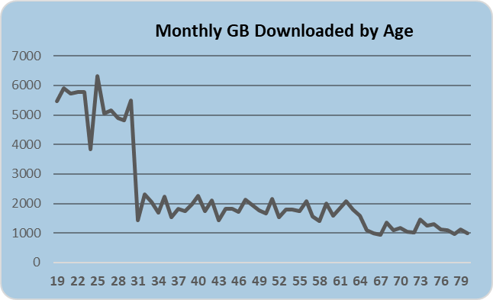
Service Usage Analysis
Customers are more preferring towards Fiber Optic Internet rather than DSL and Cable. It would be great if company focuses completely on providing Fiber Optic because other two services will be decreasing quarter by quarter. The main reason of this may be because of speed of the internet in fiber optic is more than than DSL & Cable.
Also Customers are preferring Offer A and Offer B more than the rest of the offer ,that is Offer C, Offer D and Offer E, so company can tell the marketing team to do promotion more on Offer A & Offer B and renew plans for that offers to make it more effective. Also major changes in Offer C, Offer D, Offer E is necessary as it is effecting consumption by the customer.
In offer A, more percentage of customers are subscribing to Multiple Lines, Online Backup, Online Security, Tech Support, Device Protection.
Also Customers from Age 19 to 31 , that is young age category has most number of average gb of data downloaded

Slide 6
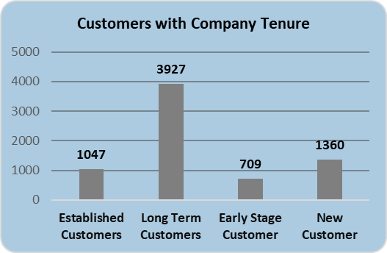
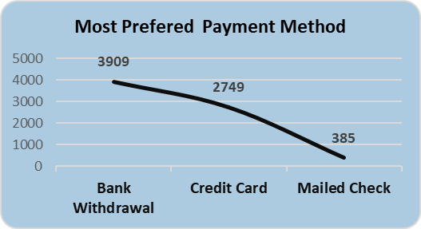
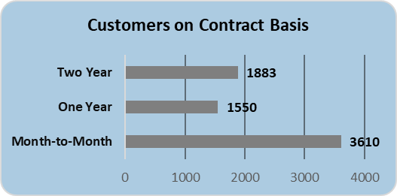
Subscriptions & Billing Preference
Here customers subscribed to our service is for Long Term which is more than 24 months, were 1360 where 485 new customers are from North California and only 2 customers are from West California, here we have to focus more on South and West California.
Also customers are preferring more bank withdrawal payment method rather than credit card and mailed check, so next target for quarter will to increase the credit card payment method. Suggestion for increasing credit card payment is to offer a month free service on Credit Card payment and also offering Offer A through credit card.
The customers are preferring monthly contract rather than one year contract or two year contract, and the total refund is from month to month contract. The reason behind this will be customer switching to competitor’s service because of better service provided by them.

Slide 7
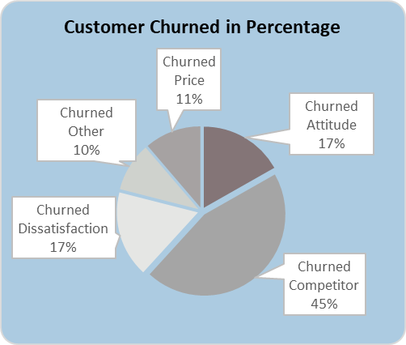
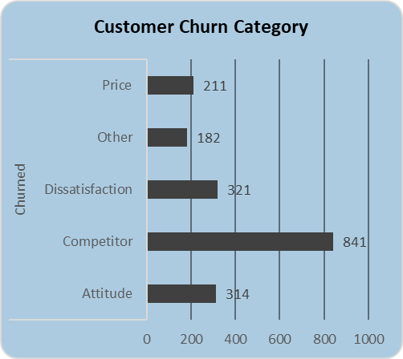
Churn Analysis
45% of customers churned due to competitors service that is total 841 customers opted to competitors service. Also if we look at the other reasons then the customers left due to price, dissatisfaction, attitude.
To overcome this we issue we can conduct a competitor’s service analysis and compare to out service and find out thee differences. Further we will take effective steps to solve the problem.
If we look at the insights, the customers churned and joined the most are from North California, we can take steps to reduced the customer churned rate by providing better services and giving a delight experience to new and existing customers.
We can also provide training to the change the attitude of the employees who provide services like installation and Customer help department to adopt a positive behaviour towards the customer, we can also take survey from the customers asking them how to improve service quality and what are your expectations from our services.

Slide 8
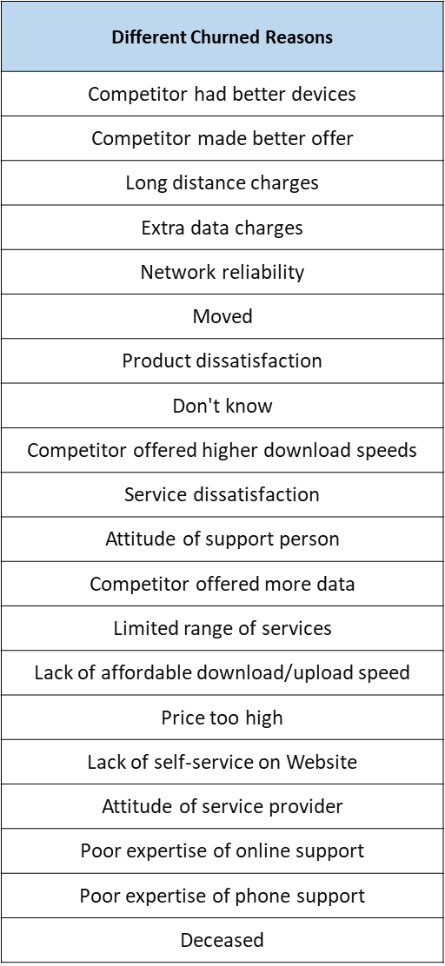
Churn Analysis
There are 20 reasons for churning of customers we can take steps to rectify all the issues one by one with the help of other department for example , customers are churned due to product dissatisfaction, we can take steps to improve the product that will able to compete the competitors product. Also for improvement of product, there will be need of finance, we could ask the help of finance department estimate the cost for research and development.
Next to focus is the quality of the service provided, customers have the issue of poor expertise of online support, poor expertise of phone support, lack of self-service on website, price too high, extra data charges, etc to overcome this company can do cost cutting in their service and reduced the price of the service but at a smaller profit so that company does not bare losses.
Competitors are making better offer than our company, we could offer customers a combine service offer that includes multiple lines, online backup, online security, Premium tech support, better device protection also upto specific GB of free data(as per company’s ability) with free streaming tv, music, movies. New offers will increase the new customers and can provide delight to customers expectations.

Slide 9
Thank You

